Slide 1
The future of events will be hybrid
Dr Tim Brown

Slide 2
Defining virtual and hybrid events
There are numerous definitions of what is meant by the term event but Dowson and Bassett (2018, p. 2) provide a succinct yet encompassing definition by outlining that an event is “a planned gathering with a purpose”.
This definition can be attributed to any type of event, irrespective of size, scope, or scale, and can therefore align to both physical and virtual events.
Virtual events are defined as “events represented on the internet” (McLoughlin, 2014, p. 242), and are therefore an online gathering with a purpose, which create an effective online environment for people to engage with the event content and each other.
A hybrid event “involves a mixture of physical events with elements of virtual events usually running simultaneously and with overlapping content and interactive elements” (Sox et al., 2017, p. 946).
Technology is integral to the development and delivery of hybrid events which connects all participants digitally across multiple locations.

Slide 3
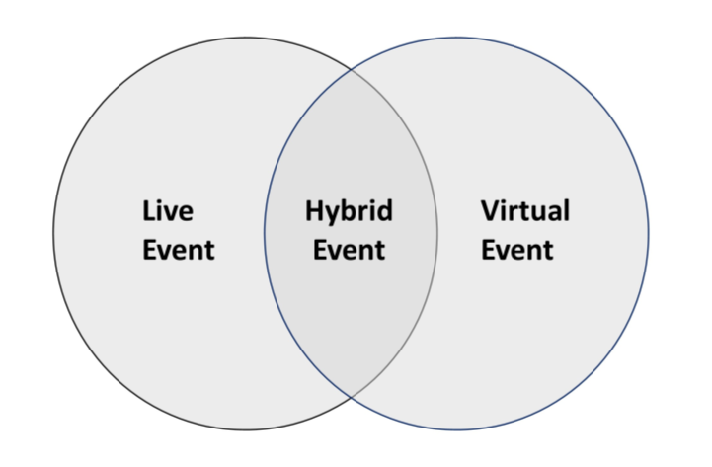
Hybrid events lie at the intersection of where live, in person events and virtual events overlap and this is portrayed in figure 1.
Designing the event experience and building in interactivity and engagement via appropriate technological is critical to the audience, both virtual and in person.
Figure 1. Hybrid event intersection

Slide 4
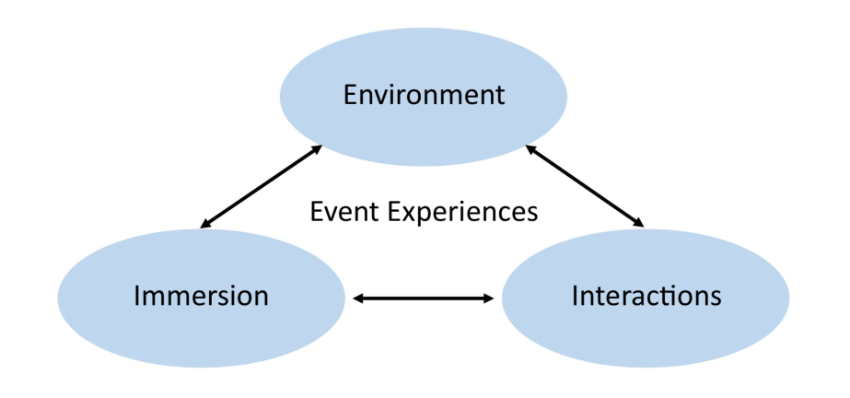
The virtual and hybrid event experience is demonstrated in figure 2.
The three aspects of environment, interactions and immersion are all intrinsically linked to the overall event experience.
The environment is both physical and virtual, and incorporates aspects such as music and audio, film, video and live stream, design, layout, and flow, which combined creates the event aesthetics.
The quality of the environment design, therefore, will result in increased interactivity and immersion by participants, which is critical for the success of virtual and hybrid events.
Figure 2 - Virtual and hybrid event experiences (adapted from Antchak & Ramsbottom, 2020).

Slide 5
The technological considerations (hardware and software) for virtual and hybrid events are outlined in the table below.
Technical Equipment | Virtual events | Hybrid events
Visual – Cameras | One or two high definition video cameras (or a high-quality web camera). | At least two high definition video cameras.
Visual - Lighting | Good quality natural light and positioning of speaker to this or small LED lighting. | LED lighting to full lighting rigs needed.
Audio – Microphones | A separate source plug in microphone to provide clear sound quality. | Multiple microphones (such a lapel mics and boom mics) to provide clear sound quality.
Audio – Speakers | Separate sound source (such as a sound bar). | Medium to large PA system.
Computer | Either a PC or laptop with high processing speeds. One to two monitors. | Multiple PCs or laptops with high processing speeds. At least two monitors needed per PC or laptop.
Broadband / Bandwidth | Reliable broadband and speed. | Ensure venue has an appropriate bandwidth and speed to support the broadcast.
Mixing desk | Small video mixing desk or video capture converter. | Medium to large video and sound mixing desk.
Software (if required). | Supporting software for broadcasting – such as OBS Studio. | Supporting software for broadcasting – such as OBS Studio.
Streaming | Platform being utilized – such as Zoom, Teams, YouTube or private platform. | Platform being utilized – such as Zoom, Teams, YouTube or private platform.
Interactivity tools | Polling, chat functions, video, and audio interactions, social media linking. | Polling, chat functions, video, and audio interactions, social media linking.

Slide 6
Benefits and disbenefits of virtual and hybrid events
Benefits:
• Lower costs
• Ability to connect with a larger, global audience
• More environmentally friendly:
Lower CO2 footprint
Less marketing collateral
Digital programmes and information
Less travel required
• Ease of use for the technology
• Increased familiarity with virtual technologies
• Enhanced accessibility
Disbenefits:
• Lack of audience engagement (distractions, multitasking etc)
• Zoom fatigue
• Issues with connectivity (broadband / wifi failure)
• Lack of social engagement
• Limited networking

Slide 7
Potential future trends of virtual and hybrid events.
A significant growth in hybrid events
An increase in ephemeral content
Enhanced gamification incorporated into virtual and hybrid events
Increased use of augmented reality (AR) and virtual reality (VR)
Development of hybrid event ambassadors
New training, techniques, and skills for developing / delivering virtual and hybrid events
Greater investment in developing new platforms and applications for enhancing the consumer experience
A focus on improving event content

